Slide 1
Network+ Guide to Networks Eighth Edition
Chapter 6
Wireless Networking
© 2019 Cengage. All Rights Reserved. May not be copied, scanned, or duplicated, in whole or in part, except for use as permitted in a license distributed with a certain product or service or otherwise on a password-protected website for classroom use.

Slide 2
Objectives (1 of 2)
6.1 Identify and describe various types of wireless networking characteristics
6.2 Explain the various wireless standards that support the Internet of Things
6.3 Explain 802.11 standards and innovations
6.4 Implement a Wi-Fi network

Slide 3
Objectives (2 of 2)
6.5 Secure a Wi-Fi network
6.6 Troubleshoot a Wi-Fi network

Slide 4
Characteristics of Wireless Transmissions
Wireless networks (W LANs)
Networks that transmit signals through the air via R F (radio frequency) waves
Wired and wireless signals share many similarities
Use of the same Layer 3 and higher protocols
The nature of the atmosphere makes wireless transmission different from wired transmission

Slide 5
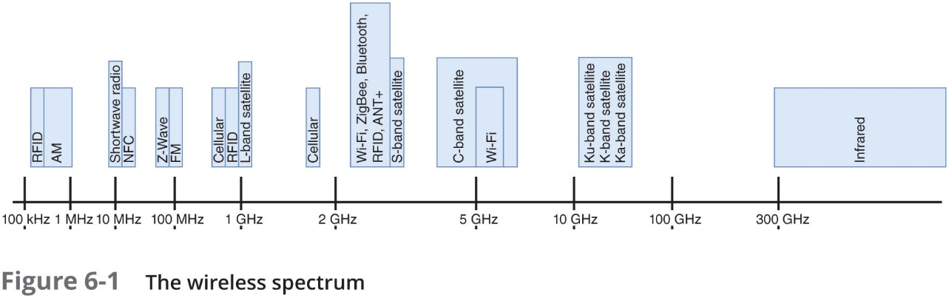
The Wireless Spectrum
The wireless spectrum is the frequency range of electromagnetic waves used for data/voice communication
Spans frequency ranges or bands between 9 kHz and 300 GHz
Some bands have only a single frequency (called a fixed frequency) for that band

Slide 6
Channel Management
Most wireless devices implement one of two technologies:
F H S S (frequency hopping spread spectrum)
D S S S (direct sequence spread spectrum)
How each wireless standard in the 2.4 GHz range uses its allotted band:
Wi-Fi uses D S S S
Bluetooth uses F H S S
ZigBee uses D S S S
A N T+ uses a fixed frequency (does not use D S S S or F H S S)

Slide 7
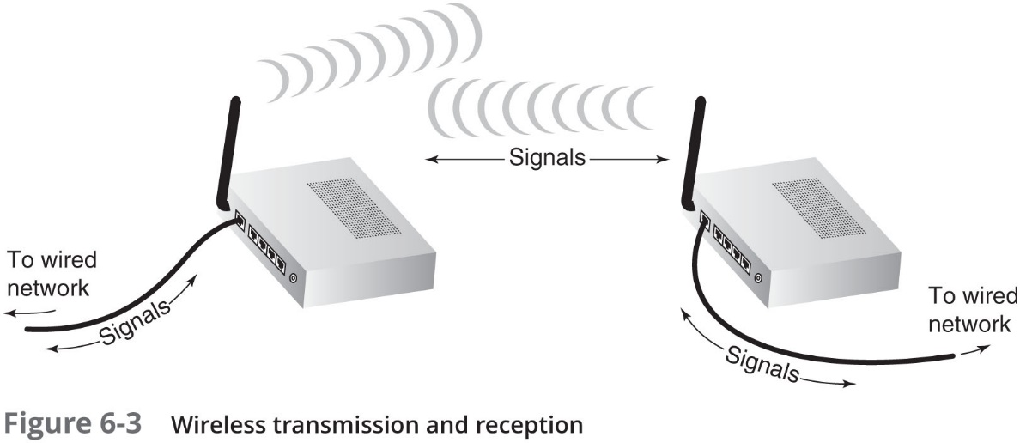
Antennas (1 of 2)
Wireless signals originate from electrical current traveling along a conductor:
Travels from the transmitter to an antenna
Antenna emits the signal as a series of electromagnetic waves into the atmosphere
At the destination, another antenna accepts the signal and a receiver converts it back to current
Two antennas must be tuned to the same frequency in order to use the same channel

Slide 8
Antennas (2 of 2)
Radiation pattern
Relative strength over three-dimensional area of all electromagnetic energy that antenna sends, receives
Unidirectional (directional antenna)
Issues wireless signals along single direction
Omnidirectional antenna
Issues, receives wireless signals with equal strength, clarity in all directions
Range
Reachable geographical area

Slide 9
Signal Propagation (1 of 4)
Propagation
The way in which a wave travels from one point to another
L O S (line of sight)
Signal travels in straight line directly from transmitter to receiver
When obstacles are in a signal’s way, the signal may:
Pass through them
Be absorbed into them
Be subject to any of the following phenomena (see next two slides)

Slide 10
Signal Propagation (2 of 4)
Fading:
As signal runs into obstacles, its energy will gradually fade
Excessive fading can cause dropped connections or slow data transmission
Attenuation:
Signal weakens
Moving away from transmission antenna
Correcting signal attenuation
Increase the power of the transmission
Repeat the signal from a closer broadcast point called a wireless range extender
Interference:
Wireless signals are more vulnerable to noise
No wireless conduit, shielding
Signal-to-noise ratio (S N R) = proportion of noise to the strength of a signal

Slide 11
Signal Propagation (3 of 4)
Refraction
As a wave travels through objects the wave’s direction, speed, and wavelength are altered (or refracted)
Reflection
Signal bounces back toward its source
Scattering
Diffusion in multiple different directions
Diffraction
Signal splits into secondary waves

Slide 12
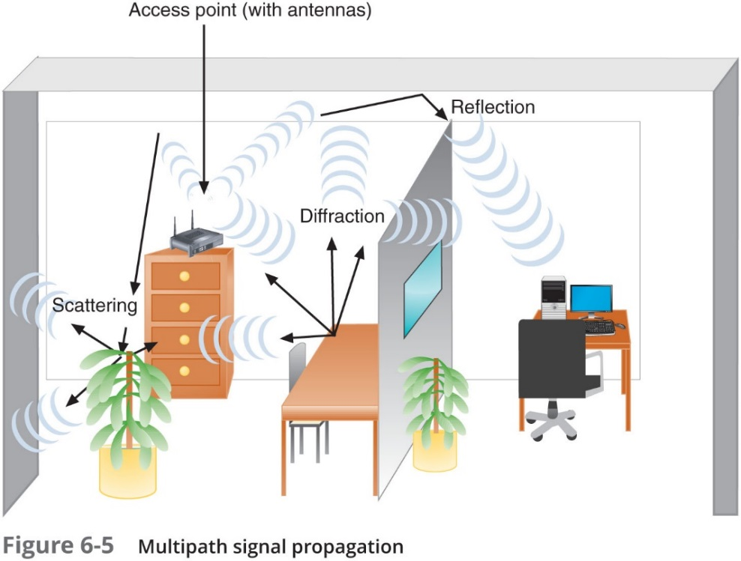
Signal Propagation (4 of 4)
Multipath signals:
Wireless signals follow different paths to destination
Advantage
Better chance of reaching destination
Disadvantage
Signal delay will result in data errors

Slide 13
Wireless Standards for the I o T (Internet of Things) (1 of 2)
I o T
Made up of any device that can be connected to the Internet
Personal monitoring devices
One of the fastest-growing areas of I o T
Smart home devices
Interlink devices such as locks and lights, security cameras, etc.
HAN (home area network)
Connected devices within a home create a type of LAN

Slide 14
Wireless Standards for the I o T (Internet of Things) (2 of 2)
W PAN (wireless personal area network)
Include short-range wireless technologies such as Bluetooth and ZigBee
PANs rarely exceed about 10 meters in any direction
Most common wireless technologies used to connect W PAN and HAN devices are discussed next

Slide 15
ZigBee
ZigBee:
Based on the 802.15.4 standard
A low-powered, battery-conserving wireless technology
Designed to handle small amounts of data
Ideal for use in I S M (industrial, scientific, and medical) sensors
Used in IoT devices for:
Building automation, H V A C control, A M R (Automatic Meter Reading), and fleet management

Slide 16
Z-Wave
Z-Wave
A smart home protocol that provides two basic types of functions:
Signaling to manage wireless connections
Control to transmit data and commands between devices
A Z-Wave network controller (called a hub)
Receives commands from a smartphone or computer and relays the commands to various smart devices on its network
Z-Wave transmissions have a range of up to 100 m per hop
Can tolerate up to four hops through repeaters

Slide 17
Bluetooth (1 of 2)
Bluetooth
Operates in the radio band of 2.4–2.4835 GHz
Hops between frequencies within that band to help reduce interference
Requires close proximity to form a connection
Exact distance requirements depend on the class of Bluetooth device
Before two Bluetooth devices can connect, they must be paired
Bluetooth interfaces are susceptible to a range of security risks
Bluejacking—A connection is used to send unsolicited data
Bluesnarfing—A connection is used to download data without permission

Slide 18
Bluetooth (2 of 2)
Table 6-2 Bluetooth power classes
Class | Maximum power output | Typical range | Purpose
1 | 100 mW | Up to 100 m | Used for industrial purposes
2 | 2.5 mW | Up to 10 m | Used for mobile devices
3 | 1 mW | Up to 1 m | Rarely used

Slide 19
A N T+
A N T+ technology is based on the A N T protocol:
An ad-hoc wireless protocol operating at about 2.4 GHz
Originally developed in 2004 and is currently owned by Garmin
A N T+ gathers and tracks information from sensors typically embedded in heart rate monitors, G P S devices, and other activity monitoring devices
A N T+ can also sync data from multiple devices for the same activity
Such as a smartwatch, smartphone, bicycle computer, or fitness equipment

Slide 20
R F I D (Radio Frequency Identification)
R F I D uses electromagnetic fields to store data on a small chip (R F I D tag)
Includes an antenna that can transmit and receive, and possibly a battery
Tag and reader combinations come in three general types:
A R P T (Active Reader Passive Tag)
P R A T (Passive Reader Active Tag)
A R A T (Active Reader Active Tag)
R F I D is commonly used for inventory management
An R F I D tag might also be embedded in a credit card
Allowing for so-called “contactless” payment

Slide 21
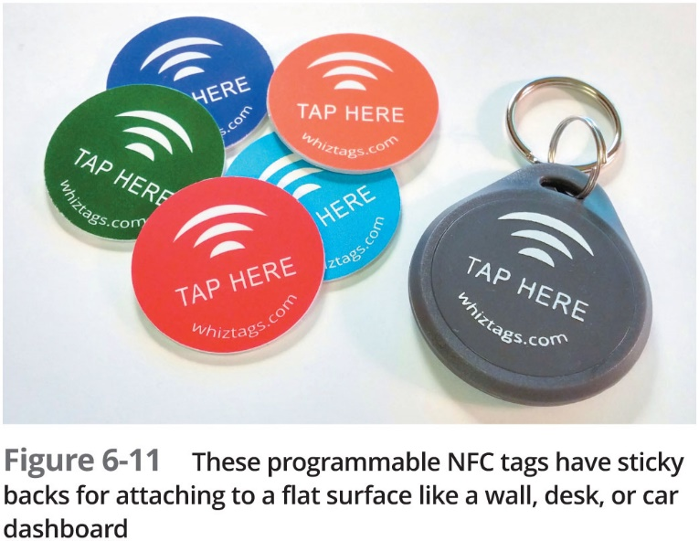
N F C (Near-Field Communication)
N F C:
A form of R F I D that transfers data wirelessly over very short distances
Signal can be transmitted one way by an N F C tag, or smart tag
When employees need access to a secure area
The N F C tag collects power from the smartphone or other device by magnetic induction

Slide 22
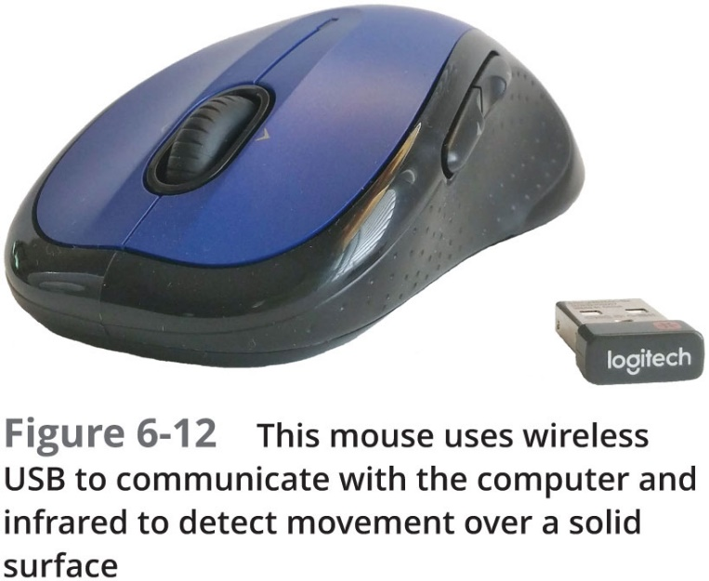
Wireless U S B
Based on the U W B (Ultra-Wideband) radio platform
Certified W-U S B products mimic wired U S B 2.0 connections
Similar speeds, security, ease of use, and compatibility
U W B radios transmit in the range between 3.1 and 10.6 GHz

Slide 23
I R (Infrared) (1 of 2)
I R is used primarily to collect data through various sensors
Exists just below the spectrum visible to the human eye
I R sensors are used to collect information such as:
Presence or level of liquid
Variations in reflections from skin caused by variations in blood flow
Proximity to the device
Commands from a control device

Slide 24
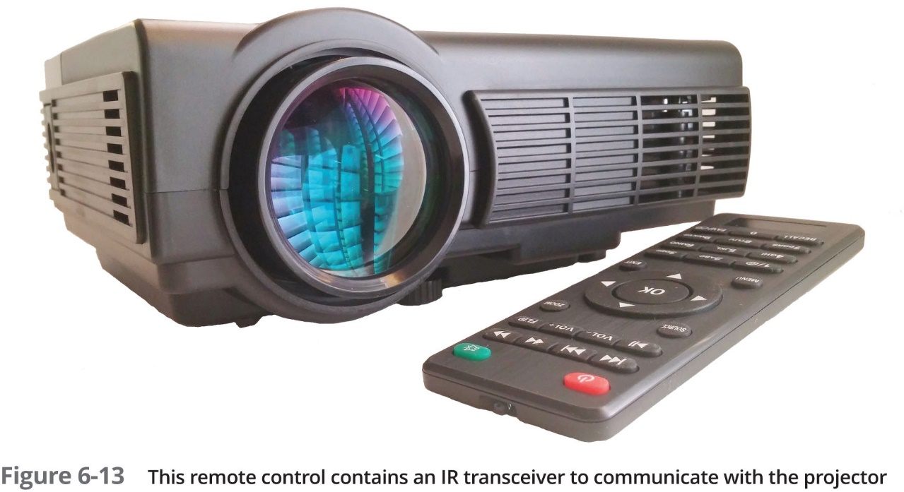
I R (Infrared) (2 of 2)

Slide 25
802.11 W LAN Standards (1 of 2)
W LANs work at O S I Layers 1 and 2
Support T C P/I P higher-layer O S I protocols and operating systems
Most popular standards used by W LANs is Wi-Fi
Developed by I E E E’s 802.11 committee
Notable Wi-Fi standards:
802.11b, 802.11a, 802.11g, 802.11n, and 802.11ac
802.11n and later modify the way frames are used at the MAC sublayer (lower portion of the Data Link layer)
L L C sublayer is primarily concerned with multiplexing, flow and error control, and reliability

Slide 26
802.11 W LAN Standards (2 of 2)
Table 6-4 Technical details for 802.11 wireless standards
Standard | Frequency band | Max. theoretical throughput | Geographic range
802.11b | 2.4 GHz | 11 Mbps | 100 m
802.11a | 5 GHz | 54 Mbps | 50 m
802.11g | 2.4 GHz | 54 Mbps | 100 m
802.11n | 2.4 GHz or 5 GHz | 600 Mbps | Indoor: 70 m Outdoor: 250 m
802.11ac Wave 1 (3 data streams) | 5 GHz | 1.3 Gbps | Indoor: 70 m Outdoor 250 m
802.11ac Wave 2 (4 data streams) | 5 GHz | 3.47 Gbps | Indoor: 70 m Outdoor 250 m
802.1ac Wave 3 (8 data streams) | 5 GHz | 6.93 Gbps | Indoor: 70 m Outdoor 250 m

Slide 27
Access Method (1 of 3)
802.11 MAC services
Append 48-bit physical addresses to frame to identify source and destination
Same physical addressing scheme as other Ethernet networks
Allows easy combination with other I E E E networks
Wireless devices:
Not designed to simultaneously transmit and receive
Cannot prevent collisions
Use different access method than Ethernet

Slide 28
Access Method (2 of 3)
C S M A/C A (Carrier Sense Multiple Access with Collision Avoidance):
Minimizes collision potential
Uses A C K packets to verify every transmission
Requires more overhead than 802.3
Real throughput less than theoretical maximum
R T S/C T S (Request to Send/Clear to Send) protocol:
Ensures packets not inhibited by other transmissions
Efficient for large transmission packets
Further decreases overall 802.11 efficiency

Slide 29
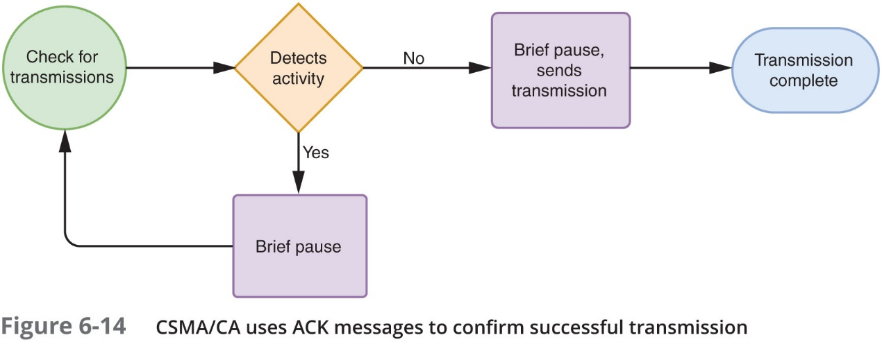
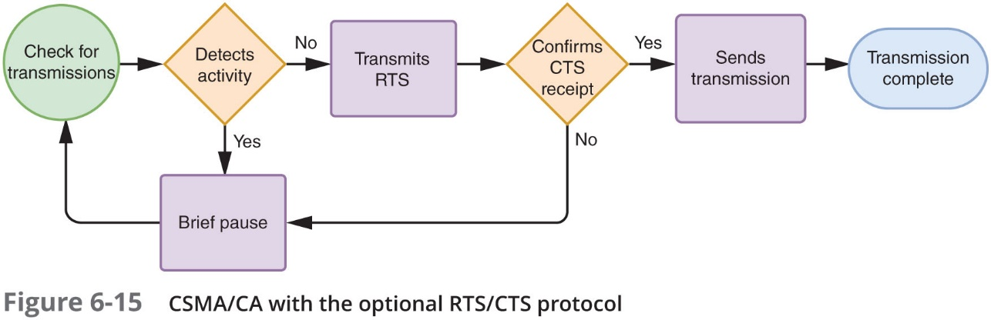
Access Method (3 of 3)

Slide 30
Association (1 of 5)
Packet exchanged between computer and access point in order to gain Internet access
Another function of the MAC sublayer
Scanning:
Surveys surroundings for access point
Active scanning transmits special frame
Known as a probe
Passive scanning listens for special signal
Known as a beacon fame

Slide 31
Association (2 of 5)
S S I D (service set identifier):
Unique character string identifying access point
In beacon frame information
Configured in access point
Better security, easier network management
B S S (basic service set):
Group of stations sharing an access point
B S S I D (basic service set identifier)
Group of stations identifier

Slide 32
Association (3 of 5)
E S S (extended service set):
Group of access points connected to same LAN
Share E S S I D (extended service set identifier)
Allows roaming
Station moving from one B S S to another without losing connectivity
As devices are moved between B S Ss within a single E S S:
Connecting to a different A P requires reassociation
Occurs by simply moving; high error rate

Slide 33
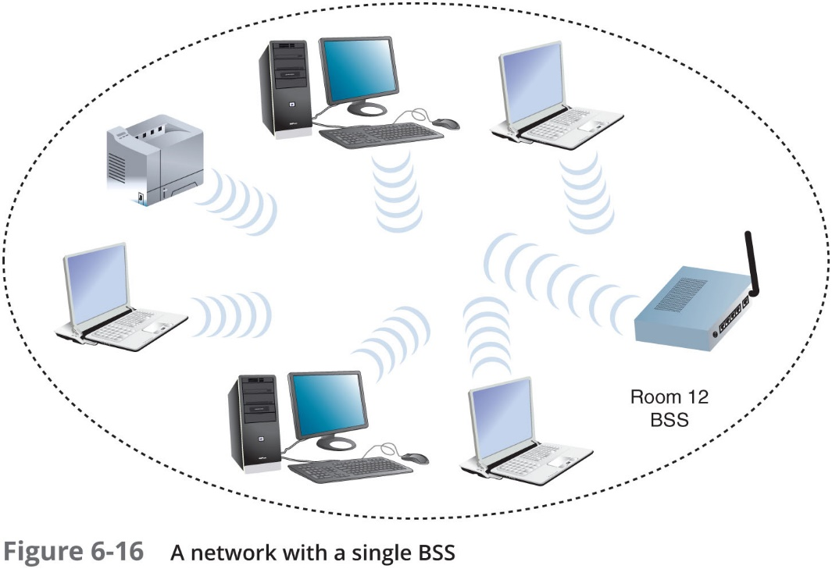
Association (4 of 5)

Slide 34
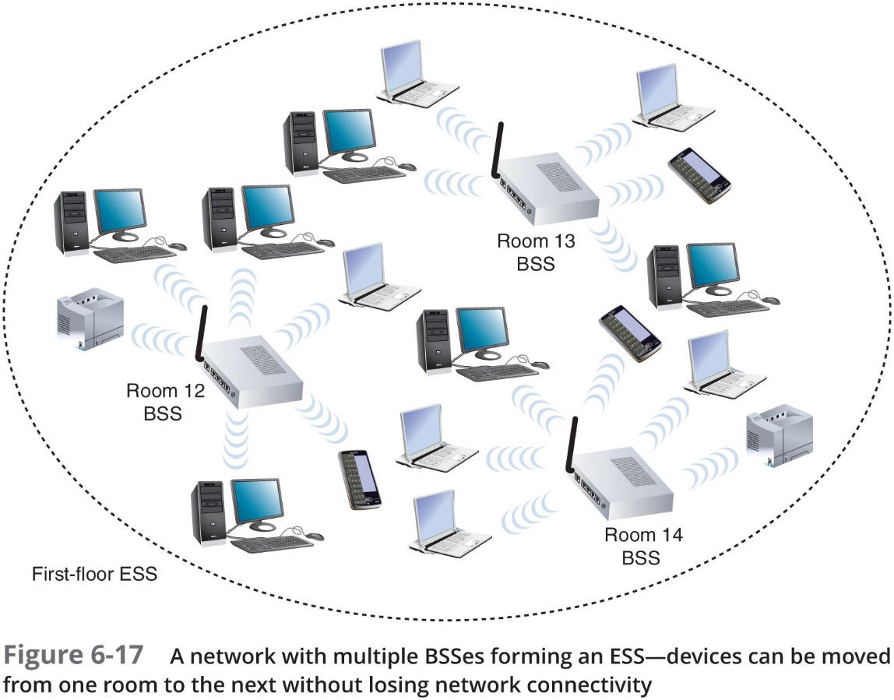
Association (5 of 5)

Slide 35
I E E E 802.11 Frames (1 of 3)
Types of overhead required to manage access to an 802.11 network
A C Ks, probes, and beacons
802.11 specifies MAC sublayer frame type
Multiple frame type groups:
Management frames: association and reassociation
Control frames: medium access and data delivery
A C K and R T S/C T S frames
Data frames: carry data sent between stations

Slide 36
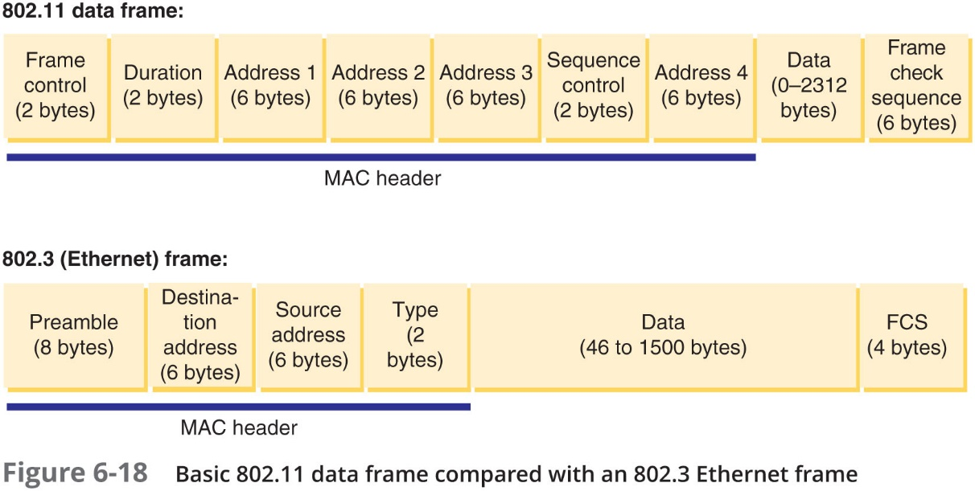
I E E E 802.11 Frames (2 of 3)

Slide 37
I E E E 802.11 Frames (3 of 3)
802.11 data frame:
Four address fields
Source address, transmitter address, receiver address, and destination address
Sequence Control field
How a large packet is fragmented
Error checking and fragmentation are handled at the MAC sublayer of the Data Link layer

Slide 38
802.11 Innovations (1 of 4)
M I M O (multiple input-multiple output):
Multiple access point and client device antennas may issue signal to one or more receivers
Increases range and network’s throughput
M U-M I M O (multiuser M I M O):
Newer technology that allows multiple antennas to service multiple clients simultaneously
Reduces congestion and contributes to faster data transmission
Available with WAVE 2 802.11ac products

Slide 39
802.11 Innovations (2 of 4)
Channel bonding
Two adjacent 20-MHz channels can be bonded to make 40-MHz channel
More than doubles the bandwidth available in single 20-MHz channel
Frame aggregation:
Combine multiple frames into one larger frame
Two techniques:
A-M S D U (Aggregated Mac Service Data Unit )
A-M P D U (Aggregated Mac Protocol Data Unit )
Advantage: reduces overhead

Slide 40
802.11 Innovations (3 of 4)
Table 6-6 Maximum frame sizes using frame aggregation
Wi-Fi Standard | A-M S D U | A-M P D U
802.11n | 7935 bytes | 65,535 bytes
802.11ac | 11,454 bytes | 4,692,480 bytes

Slide 41
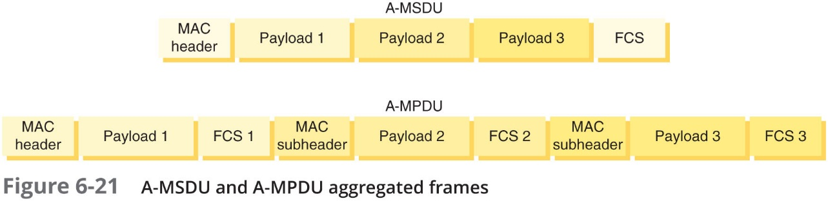
802.11 Innovations (4 of 4)

Slide 42
Implementing a Wi-Fi Network
This section describes:
W LAN technologies and how to design small W LANs
How to install and configure access points and clients on larger networks

Slide 43
Wireless Topologies (1 of 6)
Wireless networks are not laid out using the same topologies as wired networks
Wireless topologies:
Ad hoc—Small number of nodes closely positioned transmit directly to each other
Infrastructure—A WAP (wireless access point) or A P (access point) accepts wireless signals from multiple nodes and retransmits them to the rest of the network
Mesh—Several access points work as peer devices on the same network

Slide 44
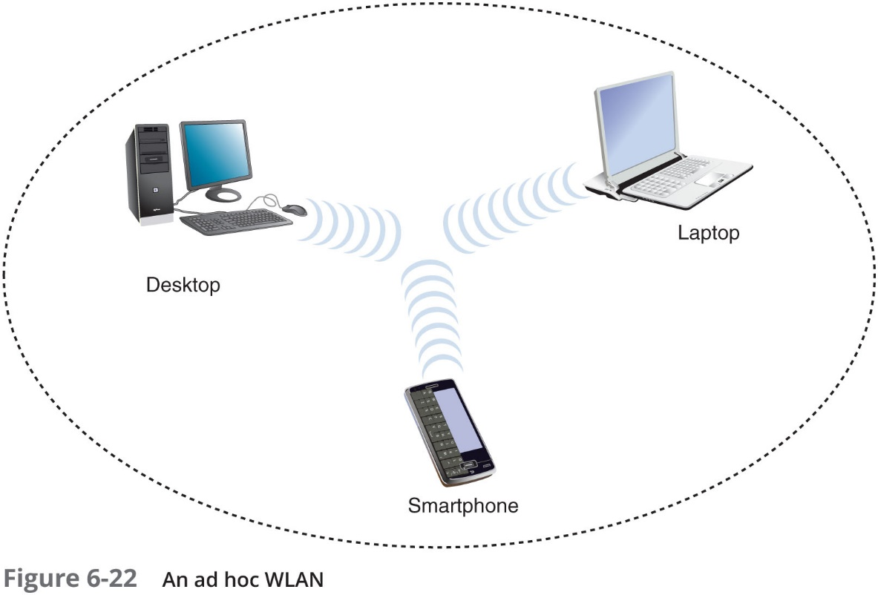
Wireless Topologies (2 of 6)

Slide 45
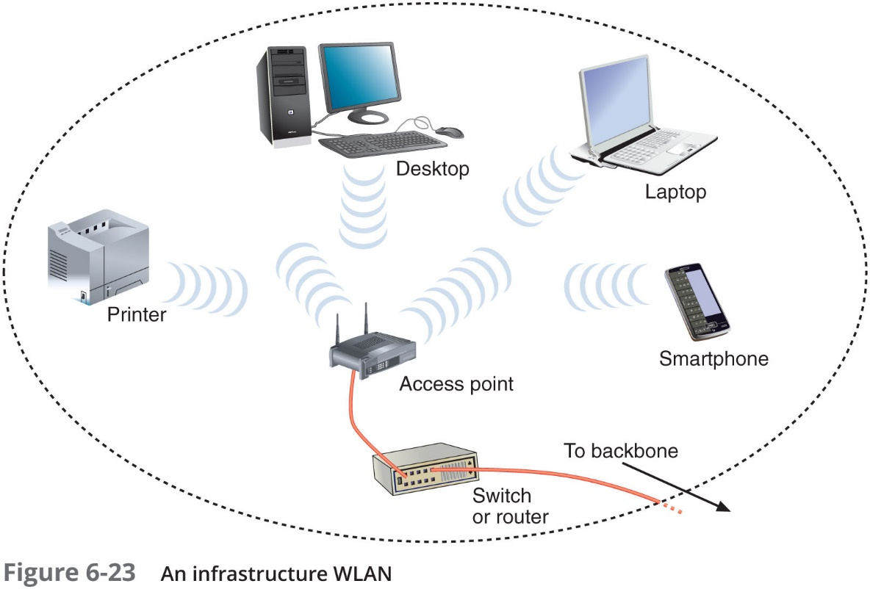
Wireless Topologies (3 of 6)

Slide 46
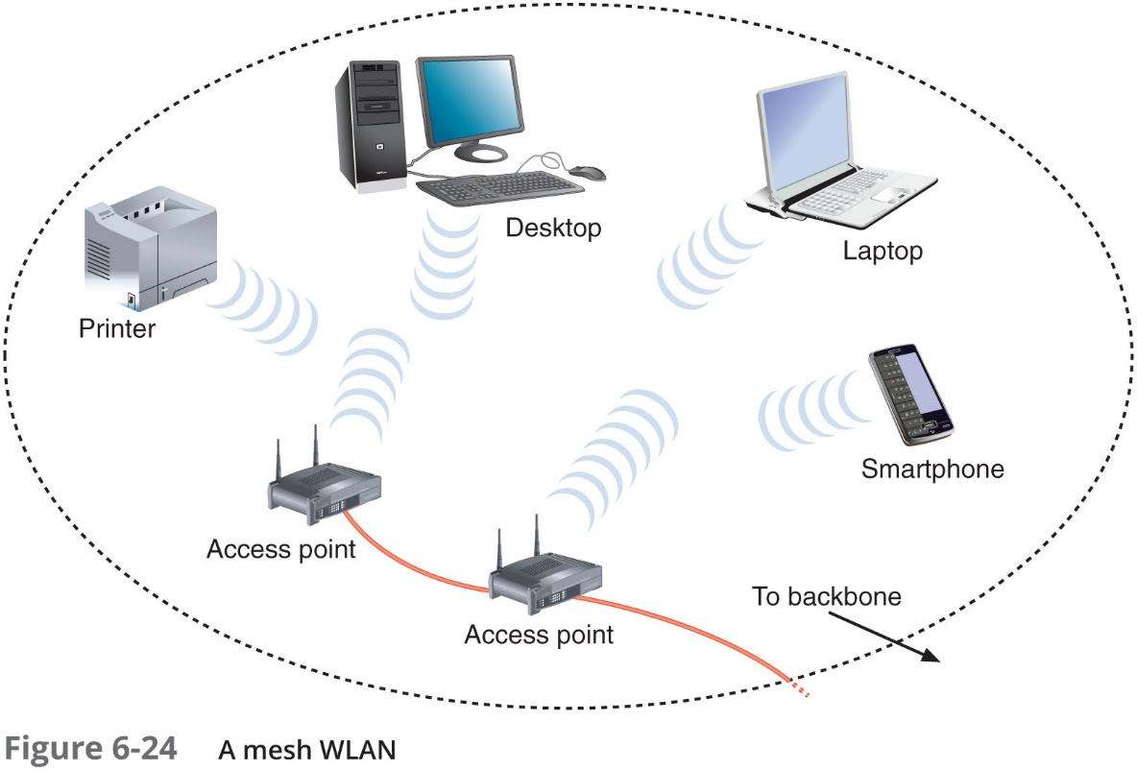
Wireless Topologies (4 of 6)

Slide 47
Wireless Topologies (5 of 6)
Centralized wireless management is made possible by a lightweight wireless protocol
Such as Cisco’s L W A P P (Lightweight Access Point Protocol) or Cisco’s C A P W A P (Control and Provisioning of Wireless Access Points)
A wireless controller can provide:
Centralized authentication for wireless clients
Load balancing
Channel management
Detection of rouge access points
Wireless technology can be used to connect two different parts of a LAN or two separate LANs

Slide 48
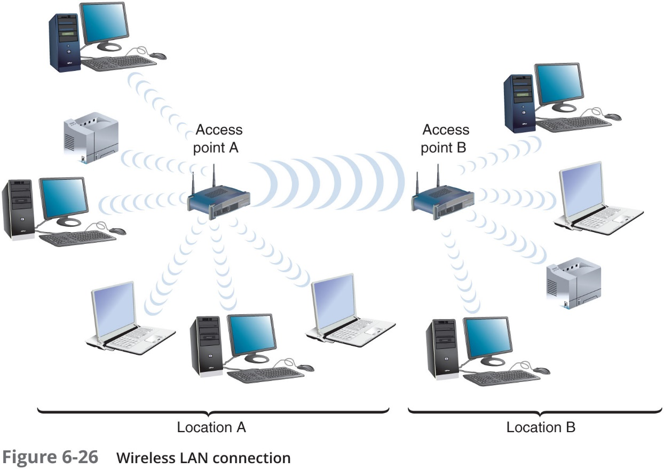
Wireless Topologies (6 of 6)

Slide 49
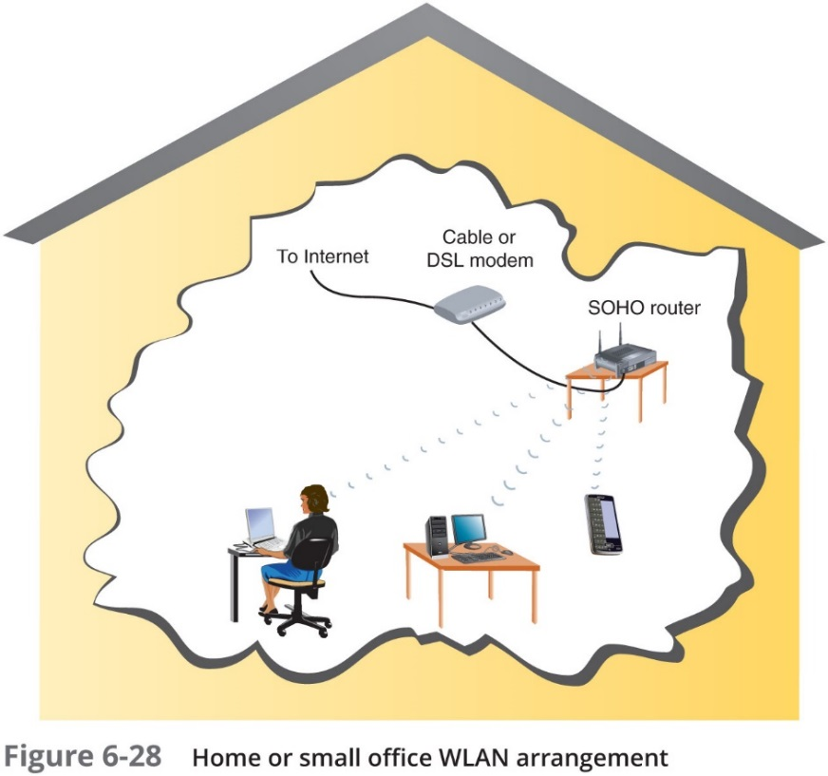
Determine the Design (1 of 4)
Home or small office network might call for only one access point:
Often combined with switching, routing functions
Connects wireless clients to LAN
Acts as Internet gateway

Slide 50
Determine the Design (2 of 4)
Consider the following when deciding where to install an A P:
Distance
Type and number of obstacles
Coverage
Interference
Larger W LANs warrant a more systematic approach to access point placement
Site survey:
Assesses client requirements, facility characteristics, coverage areas
Determines access point arrangement ensuring reliable wireless connectivity
Within given area

Slide 51
Determine the Design (3 of 4)
A thorough site survey might include:
Studying building blueprints to identify potential obstacles
Consider whether Wi-Fi access points will be used as wireless bridges to create remote wired access to the network
Determine whether certain floors require multiple A P s
Measure the signal coverage and strength from other W LANS
Test proposed access point locations
Test wireless access from the farthest corners of your space
Consider the materials used in objects that aren’t always present in the environment
Consider how the wireless portions of the LAN will integrate with the wired portions

Slide 52
Determine the Design (4 of 4)
After site survey has identified and verified the quantity and location of access points, you are ready to install them
Must belong to same E S S and share an E S S ID
Enterprise-wide W LAN design considerations
How wireless LAN portions will integrate with wired portions

Slide 53
Configure Wi-Fi Connectivity Devices
A Ps vary in which wireless standards they support, their antenna strength, and other features
Variables set during installation:
Administrator password
S S I D
Whether or not the S S I D is broadcast
Security options
Whether or not D H C P is used

Slide 54
Configure Wi-Fi Clients
Configuration varies from one client type to another
As long as an AP is broadcasting its S S I D
Clients in its vicinity will detect it and offer the user the option to associate with it
On-boarding
Installing a specific program or app onto a device to give it trusted access to certain portions of the network
Off-boarding:
Removing programs that gave devices special permissions on the network
Administrators need a feature that allows them to off-board remotely (in case A P is lost or stolen)
Called a remote wipe

Slide 55
Wi-Fi Network Security
802.11 standard security:
None by default
S S I D: only item required
Authentication
Process of comparing and matching a client’s credentials with the credentials in a database
MAC filtering
Prevents the A P from authenticating any device whose MAC address is not listed
Encryption
Use of an algorithm to scramble data

Slide 56
W P A/W P A2 (Wi-Fi Protected Access) (1 of 2)
W P A
Dynamically assigns every transmission its own key
W P A2
Replacement for W P A
A stronger encryption protocol
Most secure communication is made possible by combining a RADIUS server with W P A/W P A2
Known as W P A-Enterprise or W P A2-Enterprise

Slide 57
W P A/W P A2 (Wi-Fi Protected Access) (2 of 2)
Additional security options:
Create a separate guest network through a Wi-Fi router/access point
Set up a captive portal
First page a new client sees in the browser when connecting to a guest network
Requires user to agree to a set of terms and conditions before gaining further access

Slide 58
Security Threats to Wi-Fi Networks (1 of 2)
War driving
A hacker searches for unprotected wireless networks by driving around with a laptop configured to receive and capture wireless data transmissions
War chalking
Hackers draw symbols with chalk on the sidewalk or wall near a vulnerable A P
To make it known to other hackers
Evil twin
A rogue A P planted in a network’s geological area to pose as an authorized A P

Slide 59
Security Threats to Wi-Fi Networks (2 of 2)
W P A attack:
Involves an interception of the network keys communicated between stations and A Ps
Also called WPA cracking
W P S attack:
Cracking a PIN in order to access an A Ps settings
Cracked through a brute force attack

Slide 60
Troubleshooting Wi-Fi Networks
Cable continuity and performance testers will tell nothing about wireless connections, stations, or A Ps on a network
To troubleshoot wireless LANS
You need tools that contain wireless N I Cs and run wireless protocols

Slide 61
Wi-Fi Network Tools (1 of 2)
Two types of software tools you should have:
Spectrum analyzer
Can assess the quality of the wireless signal
Wireless analyzer (Wi-Fi analyzer)
Can evaluate Wi-Fi network availability, optimize Wi-Fi signal settings, and help identify Wi-Fi security threats
List of capabilities common to wireless testing tools:
Identify transmitting access points, stations, and channels over which they are communicating
Measure signal strength from an A P

Slide 62
Wi-Fi Network Tools (2 of 2)
List of capabilities common to wireless testing tools (continued):
Indicate the effects of attenuation, signal loss, and noise
Interpret signal strength information
Ensure proper association and reassociation between APs
Capture and interpret traffic
Measure throughput and assess data transmission errors
Analyze characteristics of each channel

Slide 63
Avoid Pitfalls (1 of 2)
Wireless configuration pitfalls to avoid:
Wrong S S I D
Security type mismatch
Wrong passphrase
Overlapping channels or mismatched frequencies
Mismatched standards
Incorrect antenna placement
Interference
Simultaneous wired and wireless connections
Problems with firmware updates
Unoptimized access point power levels
Inappropriate antenna type
Client saturation

Slide 64
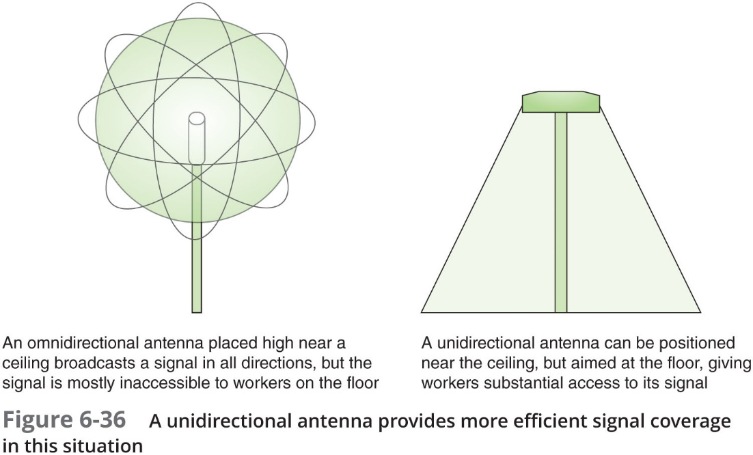
Avoid Pitfalls (2 of 2)

Slide 65
Chapter Summary (1 of 4)
LANS that transmit signals through the air via RF waves are known as W LANs
To allow multiple devices to share the same band, the band is subdivided into channels and channels are further subdivided into narrowband channels
Propagation refers to the way in which a wave travels from one point to another
The I o T (Internet of Things) is made up of any device that can be connected to the Internet
Based on the 802.15.4 standard, ZigBee is a low-powered, battery-conserving wireless technology
Z-Wave is a smart home protocol that provides two basic types of functions: signaling, to manage wireless connections, and control, to transmit data and commands between devices

Slide 66
Chapter Summary (2 of 4)
Bluetooth operates in the radio band of 2.4–2.4835 GHz and hops between frequencies within that band to help reduce interference
R F I D uses electromagnetic fields to store data on a small chip in an R F I D tag
N F C is a form of R F I D that transfers data wirelessly over very short distances
I R (Infrared) technology is used in I o T to collect data through various sensors
Wi-Fi (wireless fidelity) is a collection of wireless standards and their amendments, extensions, and corrections
Association is another function of the MAC sublayer described in the 802.11 standard
M I M O and M U-M I M O access points can only be used at full capacity when the client devices also support M I M O or M U-M I M O technology

Slide 67
Chapter Summary (3 of 4)
Wireless networks are not laid out using the same topologies as wired networks
Most small, wireless LANs use the infrastructure topology, requiring one or more A Ps
A Ps vary in which wireless standards they support, their antenna strength, and other features
As long as an A P is broadcasting its S S I D, clients in its vicinity will detect it and offer the user the option to associate with it
Authentication is the process of comparing and matching a client’s credentials with the credentials in a client database to enable the client to log on
W P A dynamically assigns every transmission its own key
Wireless transmission are susceptible to eavesdropping

Slide 68
Chapter Summary (4 of 4)
Many applications can scan for wireless signals over a certain geographical range and discover all access points and wireless nodes transmitting in the area
On every type of network, many variables must be accurately set on clients, servers, and connectivity devices in order for communication to succeed

